Slide 1
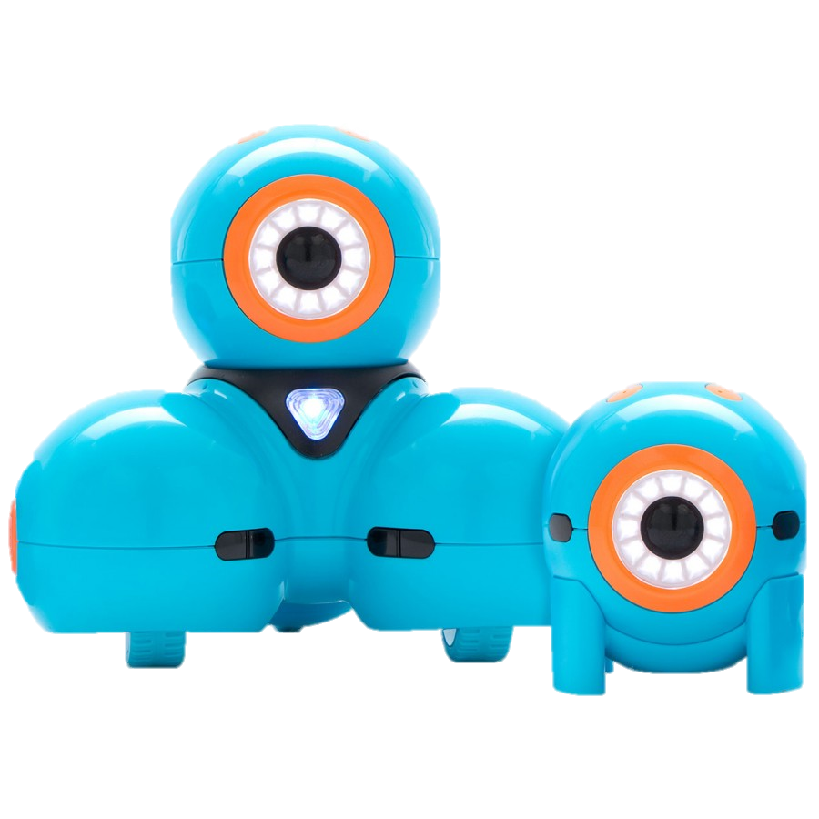
Dash Dance party

Slide 2
Dance party比賽
用Blockly App內的積木設計一個大約二十秒的程式,
指示Dash通過移動、亮燈、左右打圈、頭上下擺動、發出聲音，跳出一個美妙的舞姿。

Slide 3
Sample
The Ultimate Dance Party!!
https://www.youtube.com/watch?v=mEk62QhQ9Fc
The Ultimate Dance Party 2!!!
https://www.youtube.com/watch?v=NZ6c3Y8cSDI
The Ultimate Dance Party 3!
https://www.youtube.com/watch?v=pVow49UtlC0
The Ultimate Dance Party 4!
https://www.youtube.com/watch?v=DjZRv7r72gI

